Slide 1
Problem 2: Online Address Book
In this project, try to use classes to design an online address book to keep track of the name, addresses, phone members and birthdays of family members, close friends and certain business associate. Your implementation shall be able to handle a maximum of 500 entries.
Define the class Address that can store a street address, city, state, and ZIP code. Use the appropriate methods to print and store the address. Also, use constructors to automatically initialize the data members.
Define the class ExtPerson using the class Person and class Date (that have been introduced during the class), and the new class Address in step a). Add a data member to the class ExtPerson to clarify the person as a family member, friend, or business associate. Also, add a data member to store the phone number. Add (or override) methods to print the appropriate information. Use constructors to automatically initialize the data members.
Define the class AddressBook using previous defined clases. An object of the type AddressBook should be able to process a maximum of 500 entries.

Slide 2
Required Functions
Load the data into the address book from a file
Search for a person by last name
Print the address, phone number and date of birth (if it exists) of a given person
Print the names of the people whose birthdays are in a given month or between two given dates

Slide 3
Structure of Address Data
Shelly Malik – Person Name
12 8 2000 – Date of Birth
Lincoln Drive – Street
Omaha – City
Nebraska – State
68131 – Zip code
402-555-1212 – Phone Number
Family – Person Status

Slide 4
Code Structure
Date.java – class for processing the date
Address.java – class for processing address information
AddressBook.java – class for print and search data
Person.java – class for processing person name
ExtPerson.java – class for processing person related data (date of birth …)
Main.java – call methods to achieve the requirements.

Slide 5
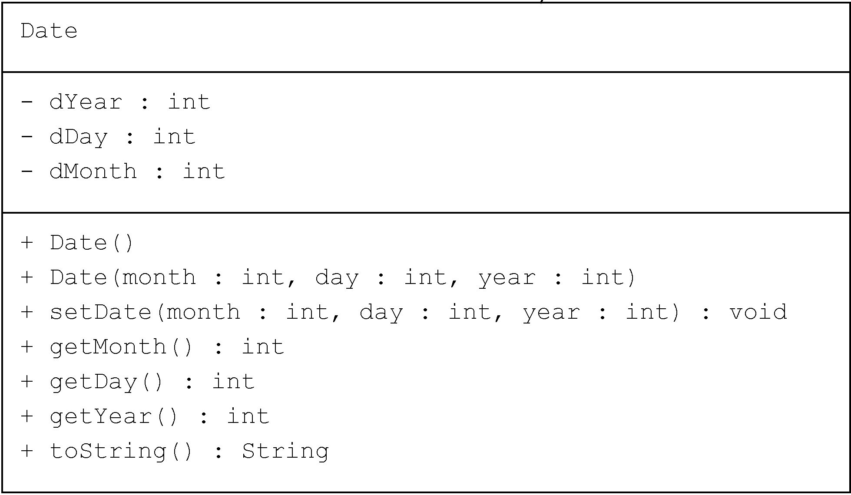
UML Design

Slide 6
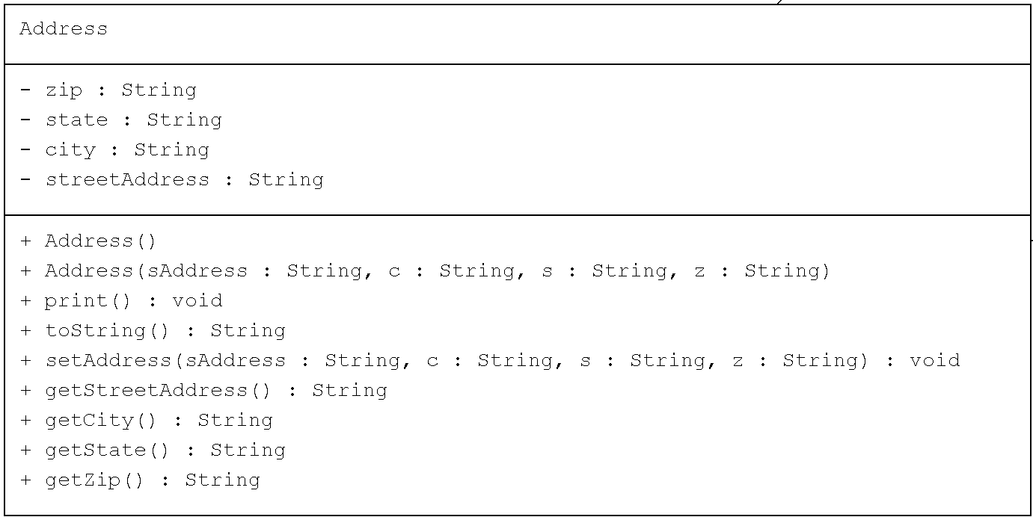
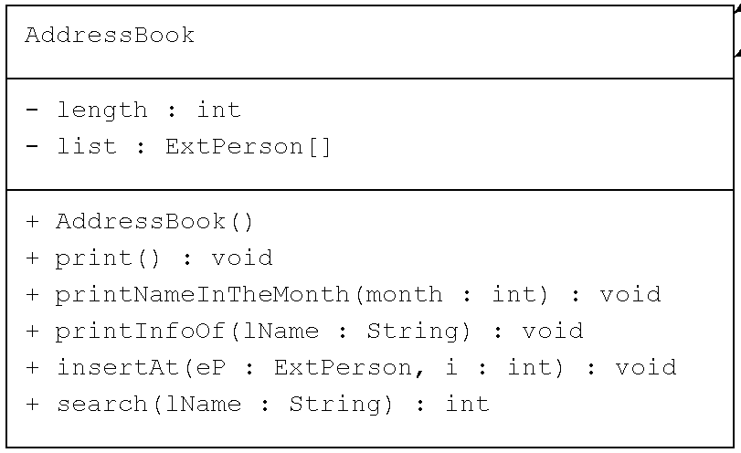
UML Design (cont.)

Slide 7
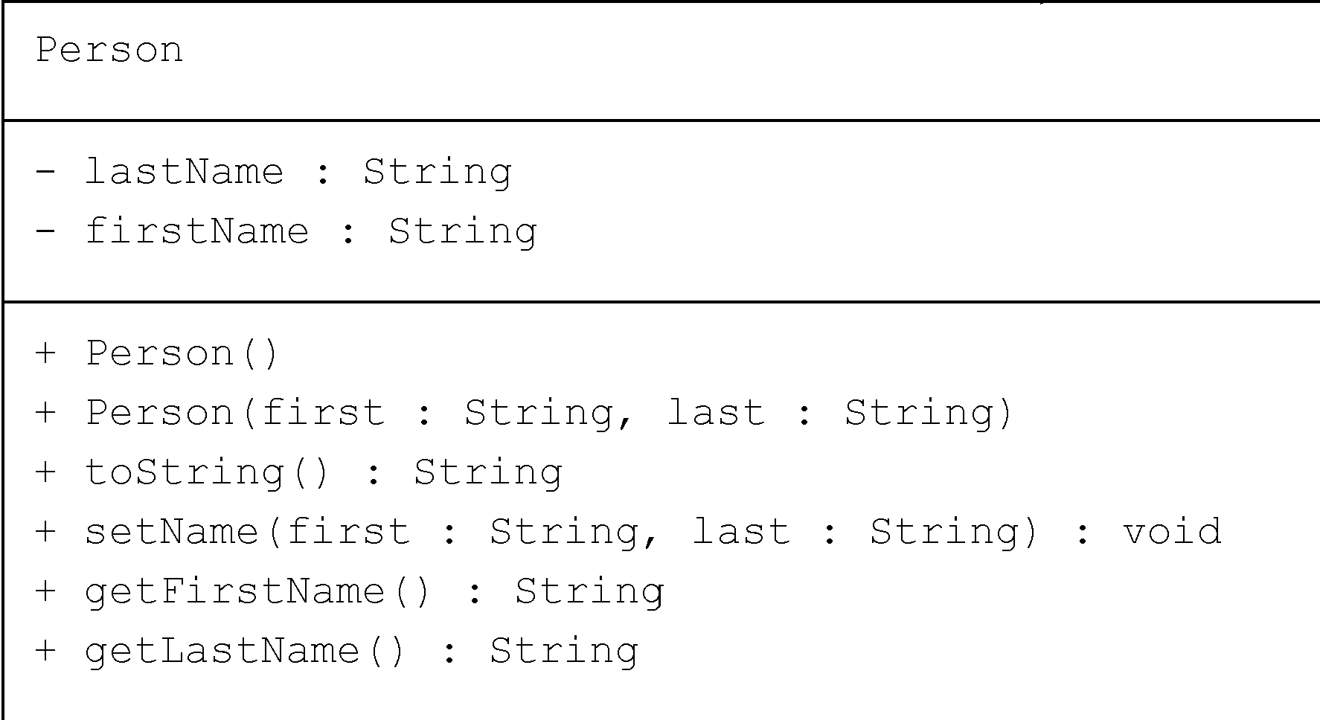
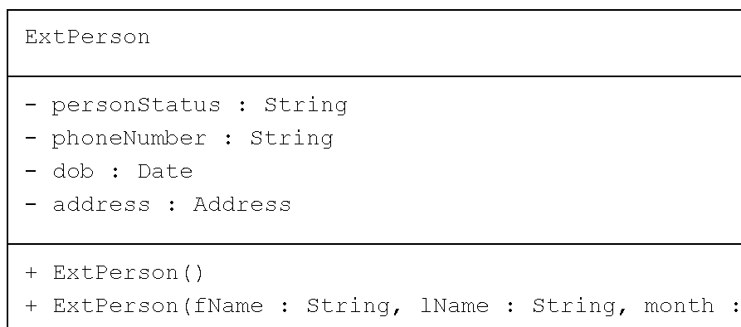
UML Design (cont.)

Slide 8
Main class
A menu to perform the required operations:
Example
System.out.println("1: To see if a person is in the address book");
System.out.println("2: Print the information of a person");
System.out.println("3: Print the names of person having birthday in a particular month");
System.out.println("4: Print all person's info");
System.out.println("9: Terminate the program");
File operation

